Slide 1


Social Buzz
Final Project Presentation
Sushma Shinde – Mar 11th 2023

Slide 2


Today's agenda
Project recap
Problem
The Analytics team
Process
Insights
Summary

Slide 3

Social Buzz is fastest growing technology unicorn that need to quickly adapt to it’s global scale.
Accenture has begun a 3 months POC focusing on these tasks below
-An audit of Social Buzz’s big data practice
-Recommendations of successful IPO
-Analysis of Social Buzz’s top 5 best performing categories.
Project Recap

Slide 4


Problem
Huge amount of unstrustured data
Active since past 5 years
Over 500 million active users/ per month
Over 100000 posts per day
36,500,000 posts per year
5 most popular categories

Slide 5



The Analytics team

Slide 6
Data Understanding
Process
1
Data Cleaning
2
3
Data Modeling
Data Visualization
4
5
Data Insights

Slide 7
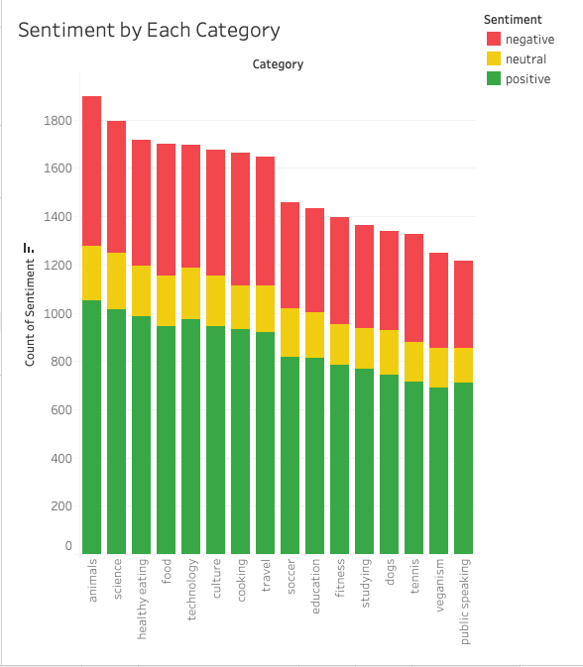
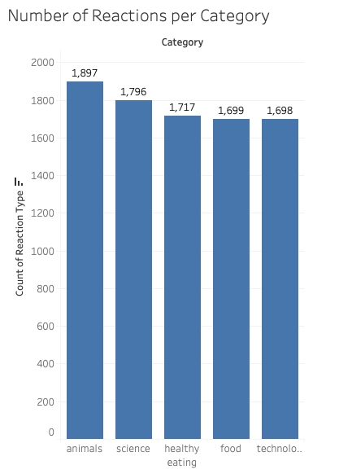

Slide 8
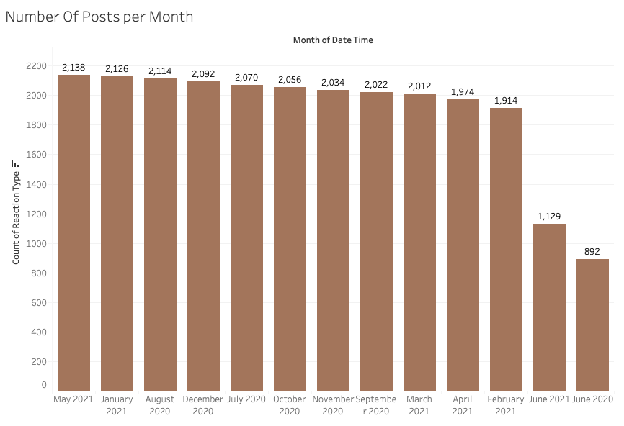

Slide 9
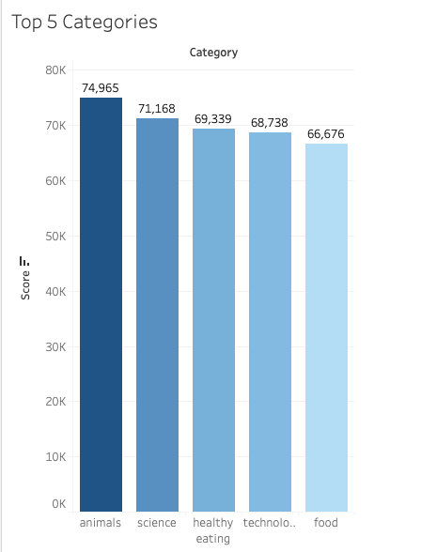
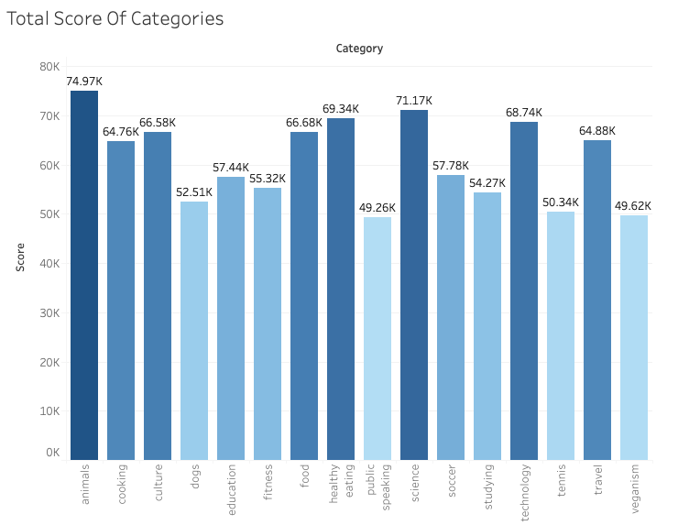

Slide 10

Insights
Top 5 categories have more number of reactions
More positive sentiments than negative
Lowest posts are in June in 2020 and 2021
February to April 10-15% fluctuation
Highest #of posts 2138 in May2021

Slide 11

The best 5 performing categories
Animals
Science
Healthy
Eating
Technology
Food
Summary

Slide 12

Thank you!
ANY QUESTIONS?

